Slide 1
Discussion 2: Scope, Pass-by-Value, Static
Christine Zhou

Slide 2
Agenda
Announcements
Worksheet #1
Worksheet #2
Worksheet #3 (if we can!)

Slide 3
Administrivia
Lab 1 and Lab 2 due this Friday 2/1 at midnight.
Note, all labs are due Friday at midnight the week they are assigned.
Proj0 NBody also due Friday at midnight.
If you haven’t started please start ASAP!
Office hours and exam prep/LOST sections start this week! See calendars on the course website.
Pre-semester Advising: @414 or email me!
Discussion survey: http://tinyurl.com/cz-disc2-sp19
Good for me to collect your emails (in case I have announcements or mess up during discussion 😅)

Slide 4
Review: Defining classes
// class definition
public class IntList {
// instance variables
int head;
IntList tail;
// constructors, which will create IntList objects
public IntList() {...}
public IntList(int value, IntList tail) {...}
// you can create methods that use the instance variables!
public void insert(int val) {...}
public void removeLast() {...}
}
Notes:
You can try getting the students to write an example class together! Have a student tell you what kind of class they’d like to make (maybe ask for favorite food or animal?) Then ask people to raise their hand and give some attributes for that thing which you can use as instance variables.

Slide 5
Review: Java’s Types
Primitives:
byte, short, long, int, double, float, char, boolean
References:
Everything else!
Objects, arrays, Strings, etc.
Notes:
Ask the students: “Anyone know what the primitive types are?”
also ask: “Give me some examples of Reference types”

Slide 6
Review: Box and Pointer Diagrams
Box and Pointers are the 61B equivalent of 61A’s environment diagram
They are crucial to helping us keep track of what goes on in a program: use them!
We didn’t specify what integers are going in the array, so Java initializes it with the default value 0
int x = 29;
int[] arr = new int[3];
int x
int[ ] arr
29
0
0
0
Primitives go in the box
Reference types are referenced via pointers

Slide 7
Java is pass by value
Golden Rule of Equals AKA pass-by-value
When you do “a = b”, you always copy the bits (whatever is inside the box) of b into a.
For primitives: Directly copy the value inside b to a.
For Reference types: Copy the memory address of b into a.
Also can say “copies the pointer in b to a”
int[ ] arr1
int x = 29;
int y = x;
int[] arr1 = new int[3];
int[] arr2 = arr1;
int x
int y
0
0
0
29
29
int[ ] arr2

Slide 8
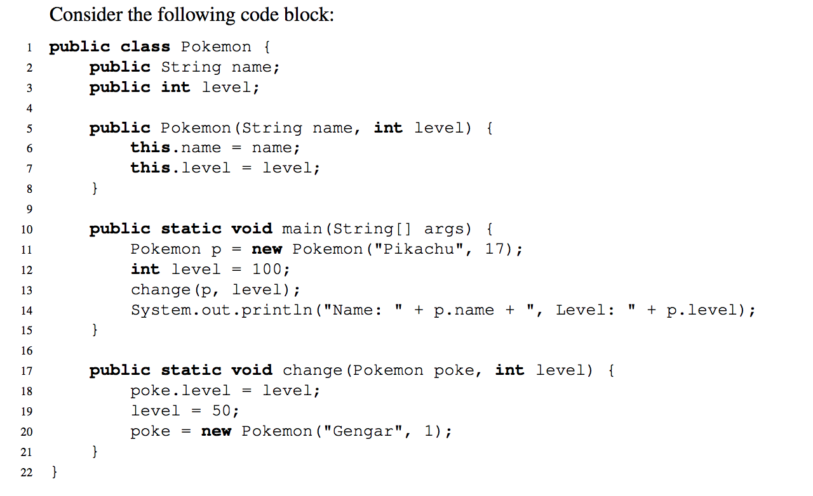
Pass by What?
Java Visualizer
Notes:
We wanna know what’s happening inside “main”
We start at this line.
Draw out the box and pointer diagrams on the board. Ask the students to tell you what to draw at each line

Slide 9
Review: Static Variables/Methods
Static == belong to the class
Shared by all instances of the class
Doesn’t need to be called from any particular instance and doesn’t need access instance variables.
Should be accessed via dot notation with the class name, not instance (though instance does work, just bad style)
Human.population is better than christine.population
public class Human {
public String name;
public int age;
public static int population;
public void happyBirthday() {...}
public static void getPopulation() {...}
public static void main(String[] args) {
Human christine = new Human();
}
}

Slide 10
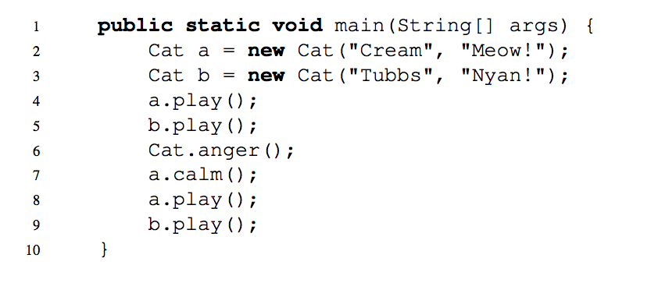
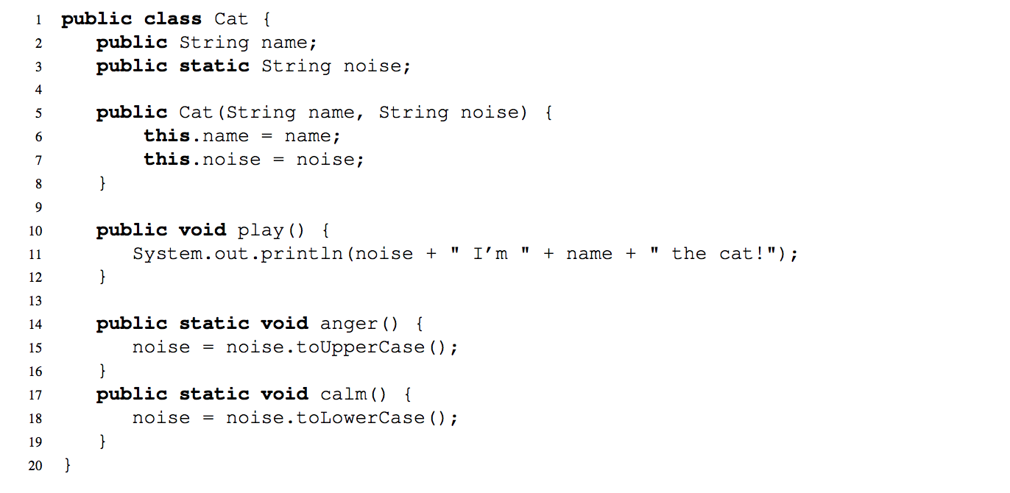
2) Static Methods and Variables
Java Visualizer

Slide 11
Review: IntLists
IntLists are the equivalent of 61A’s “Linked List” with one restriction: it can only hold integers.
Each IntList consists of 2 elements:
an integer first
an IntList rest
IntList l first rest
1
2
3

Slide 12
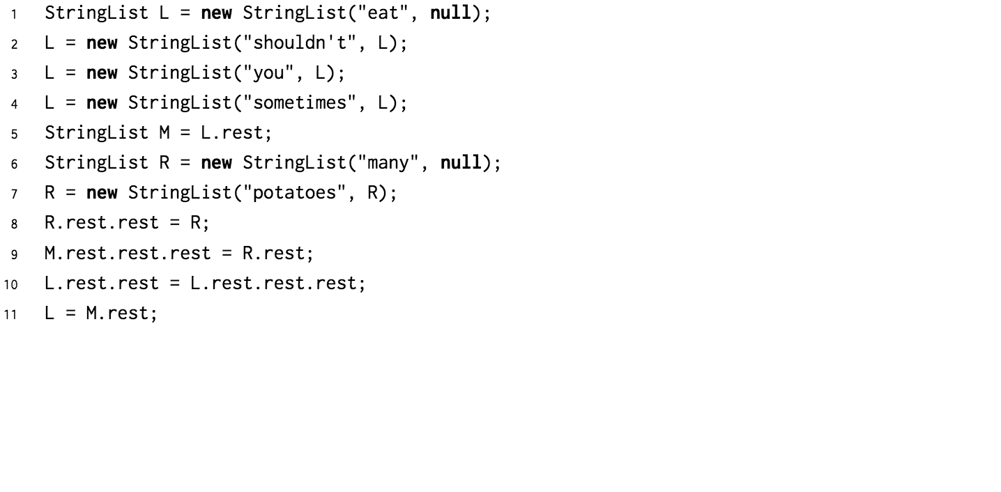
3) Practice with Linked Lists
The golden rule of equals applies here!
Golden Rule of Equals AKA pass-by-value
When you do “a = b”, you copy the bits (whatever is inside the box) of b into a.
For primitives: Directly copy the value inside b to a.
For Reference types: Copy the memory address of b into a. “Copies the pointer in b to a”
Java Visualizer
Notes:
Can walk through the solution with them on the board or use Java visualizer

Slide 13
4) Extra: Squaring a List
Components of recursion:
Base case
Recursive call
Composition
public static IntList square(IntList L) {
public static IntList squareDestructive(IntList L) {

Slide 14
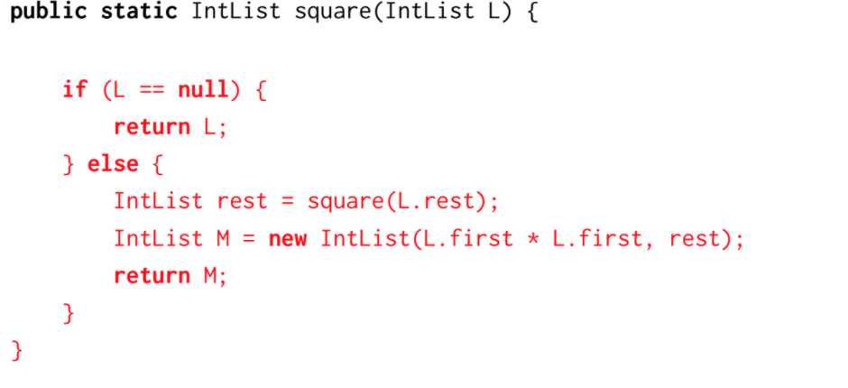
4) Extra: Squaring a List
Components of recursion:
Base case
Recursive call
Composition

Slide 15
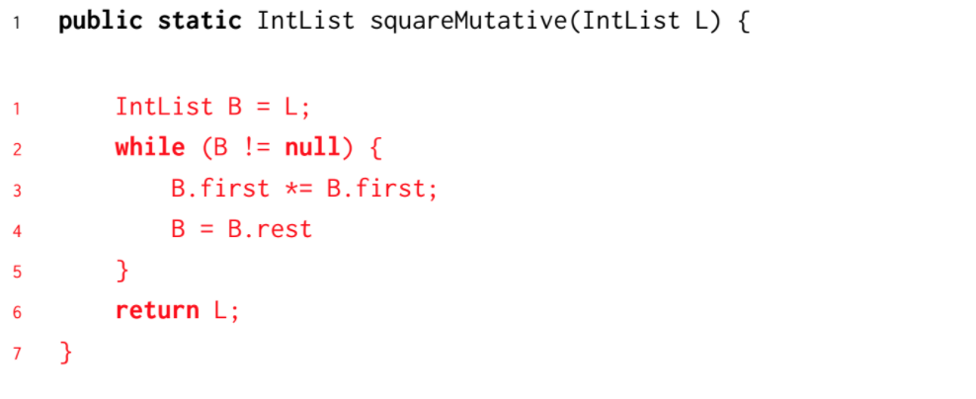
4) Extra: Squaring a List
Components of recursion:
Base case
Recursive call
Composition

